Slide 1

Etosha Cave
Converting Waste CO₂ into Wealth

Slide 2


Slide 3

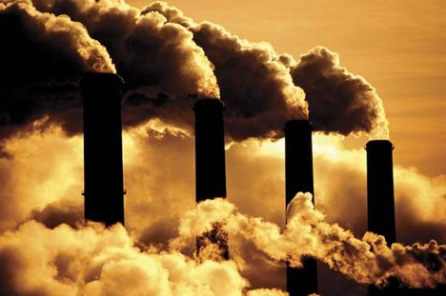

Slide 4
What if we rewrite the story of waste CO₂?

Slide 5
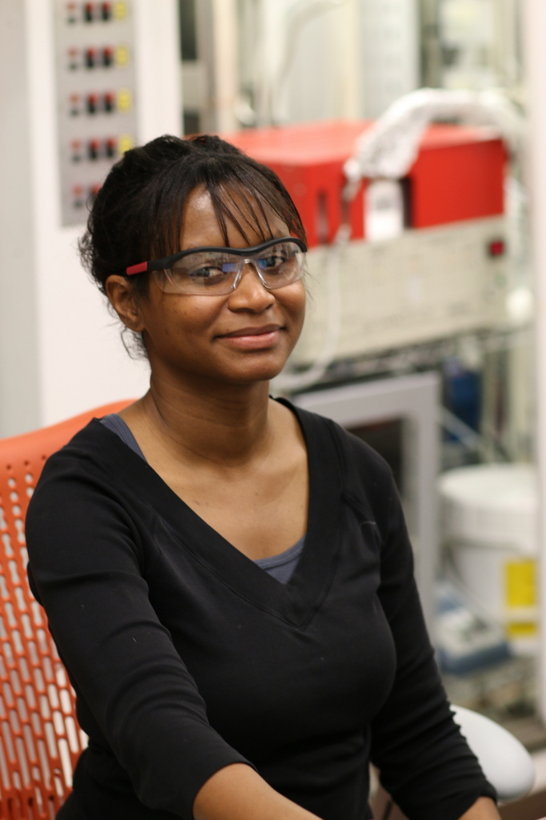
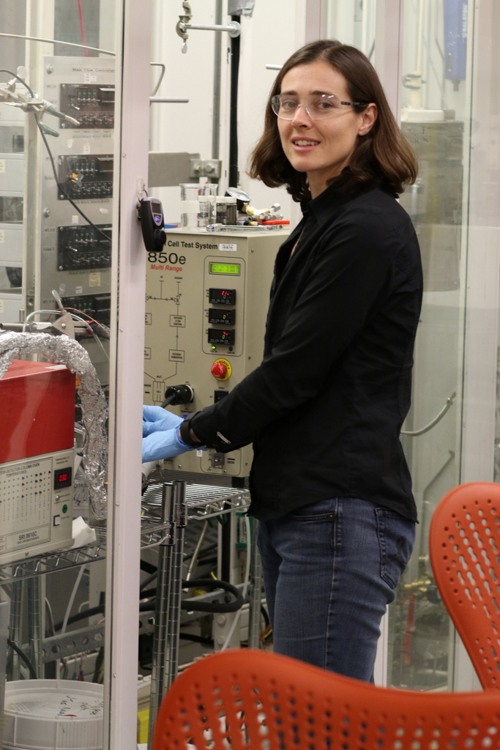


Slide 6
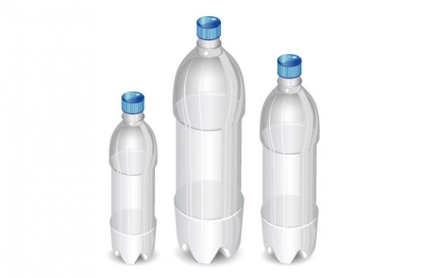
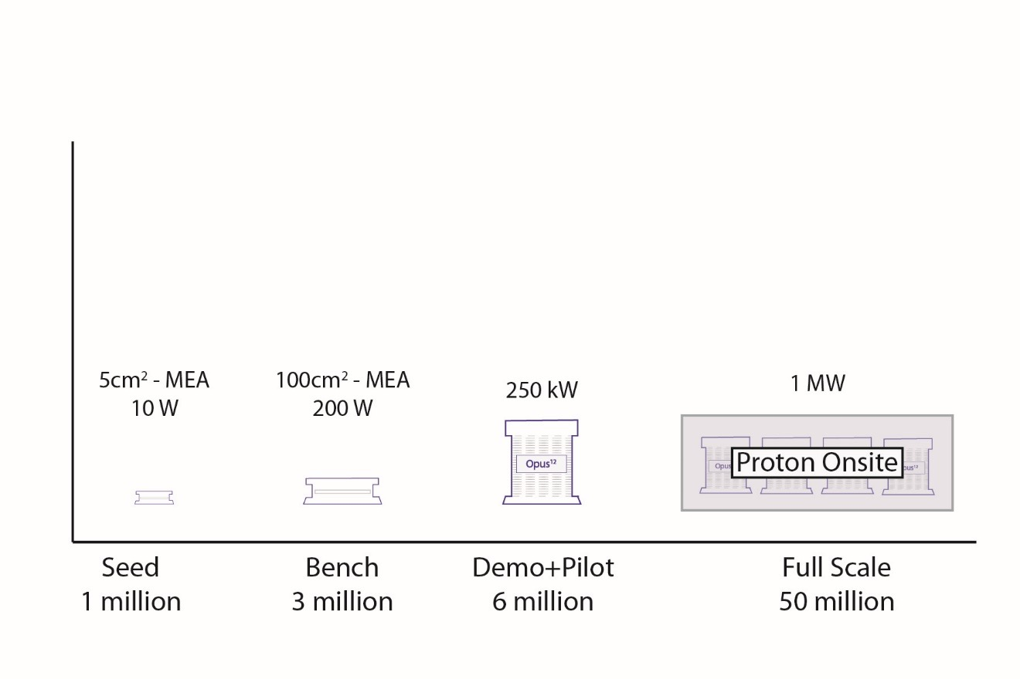
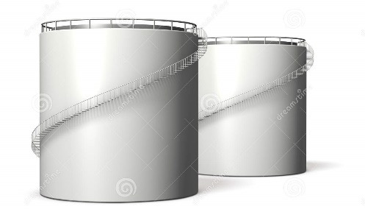
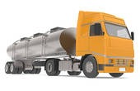

CO₂
Carbon Product
water
oxygen
Electricity

Slide 7
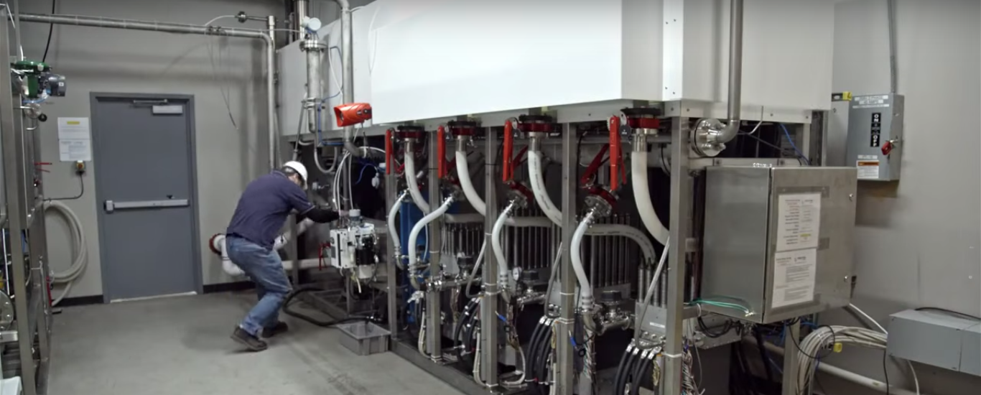
Existing reactors
Like 37,000 trees...in a suitcase

Slide 8


Slide 9
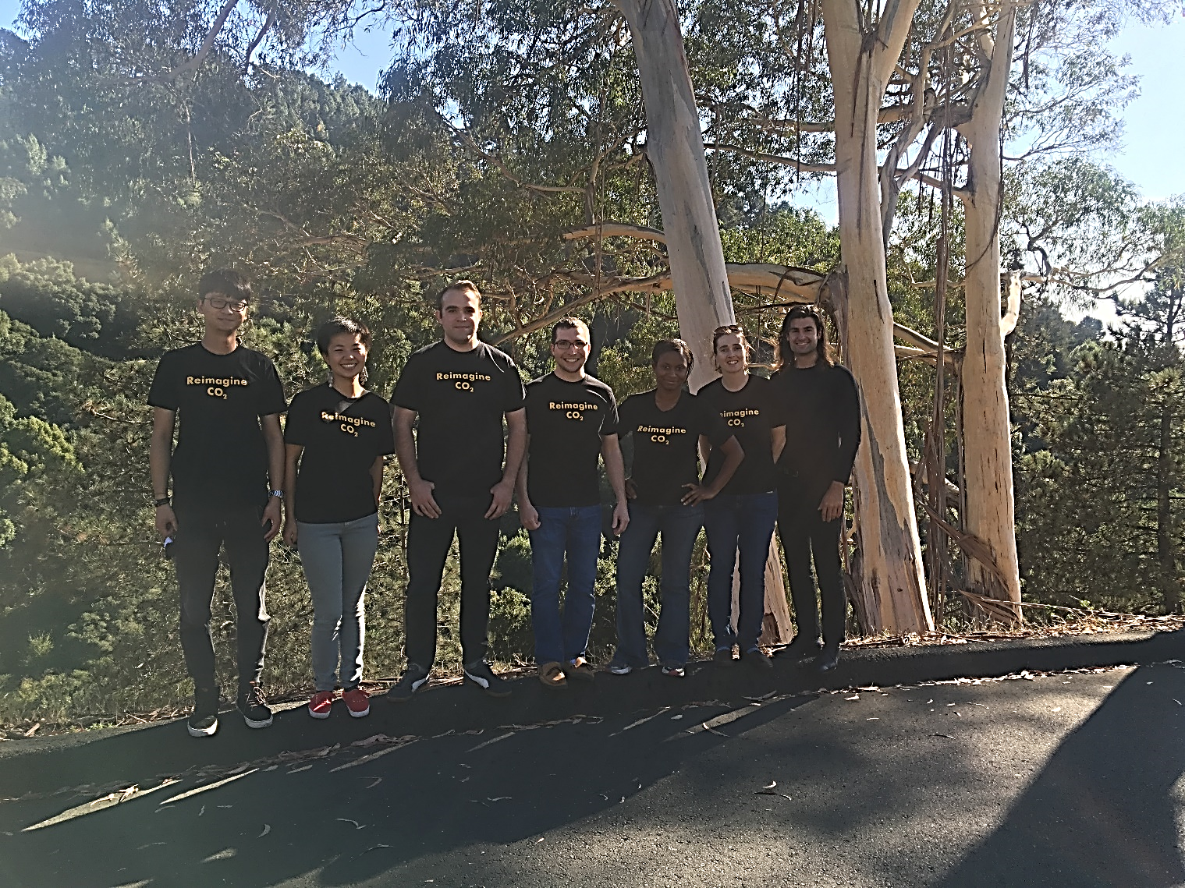
Team Opus 12

Slide 10
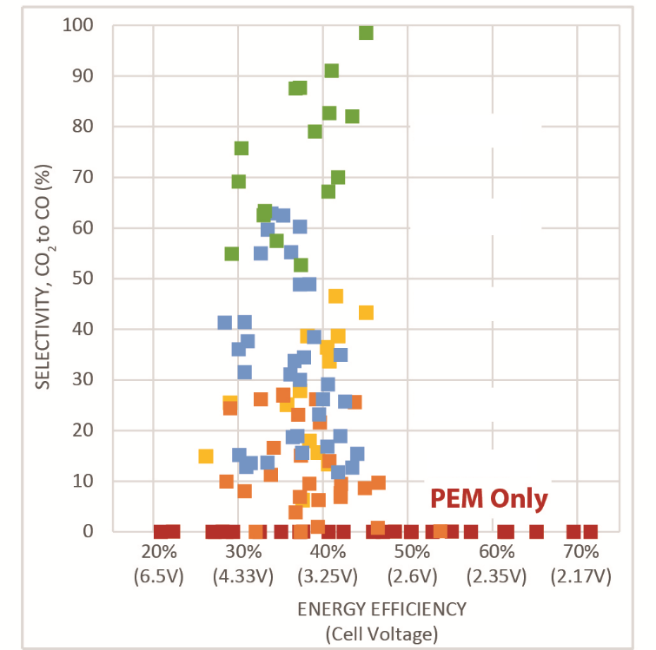
Gen 4
Gen 3
Achieved over 99% selectivity
Selectivity (%)
Selectivity, CO₂ to CO, %
Gen 2
Gen 1
Baseline
Efficiency (%)
Voltage efficiency (cell potential)

Slide 11
10x Cost Advantage

Slide 12












$1.9 million in grant funding to date
DOE
Government
Strategic
Manufacturing partner
Highly selective incubators

Slide 13
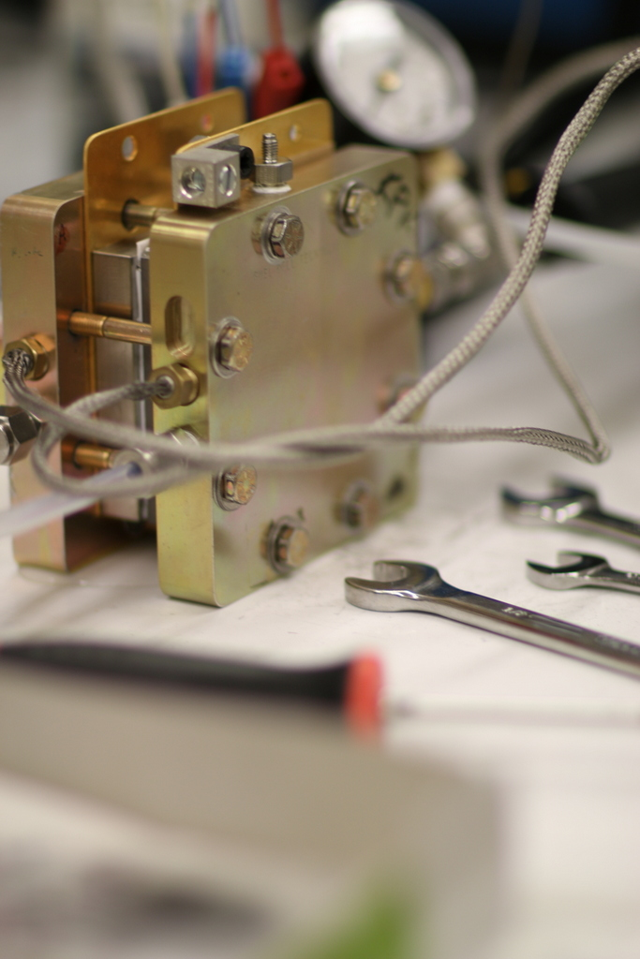

Prototype
Product

Slide 14
Rewriting the story of CO₂

